Slide 1
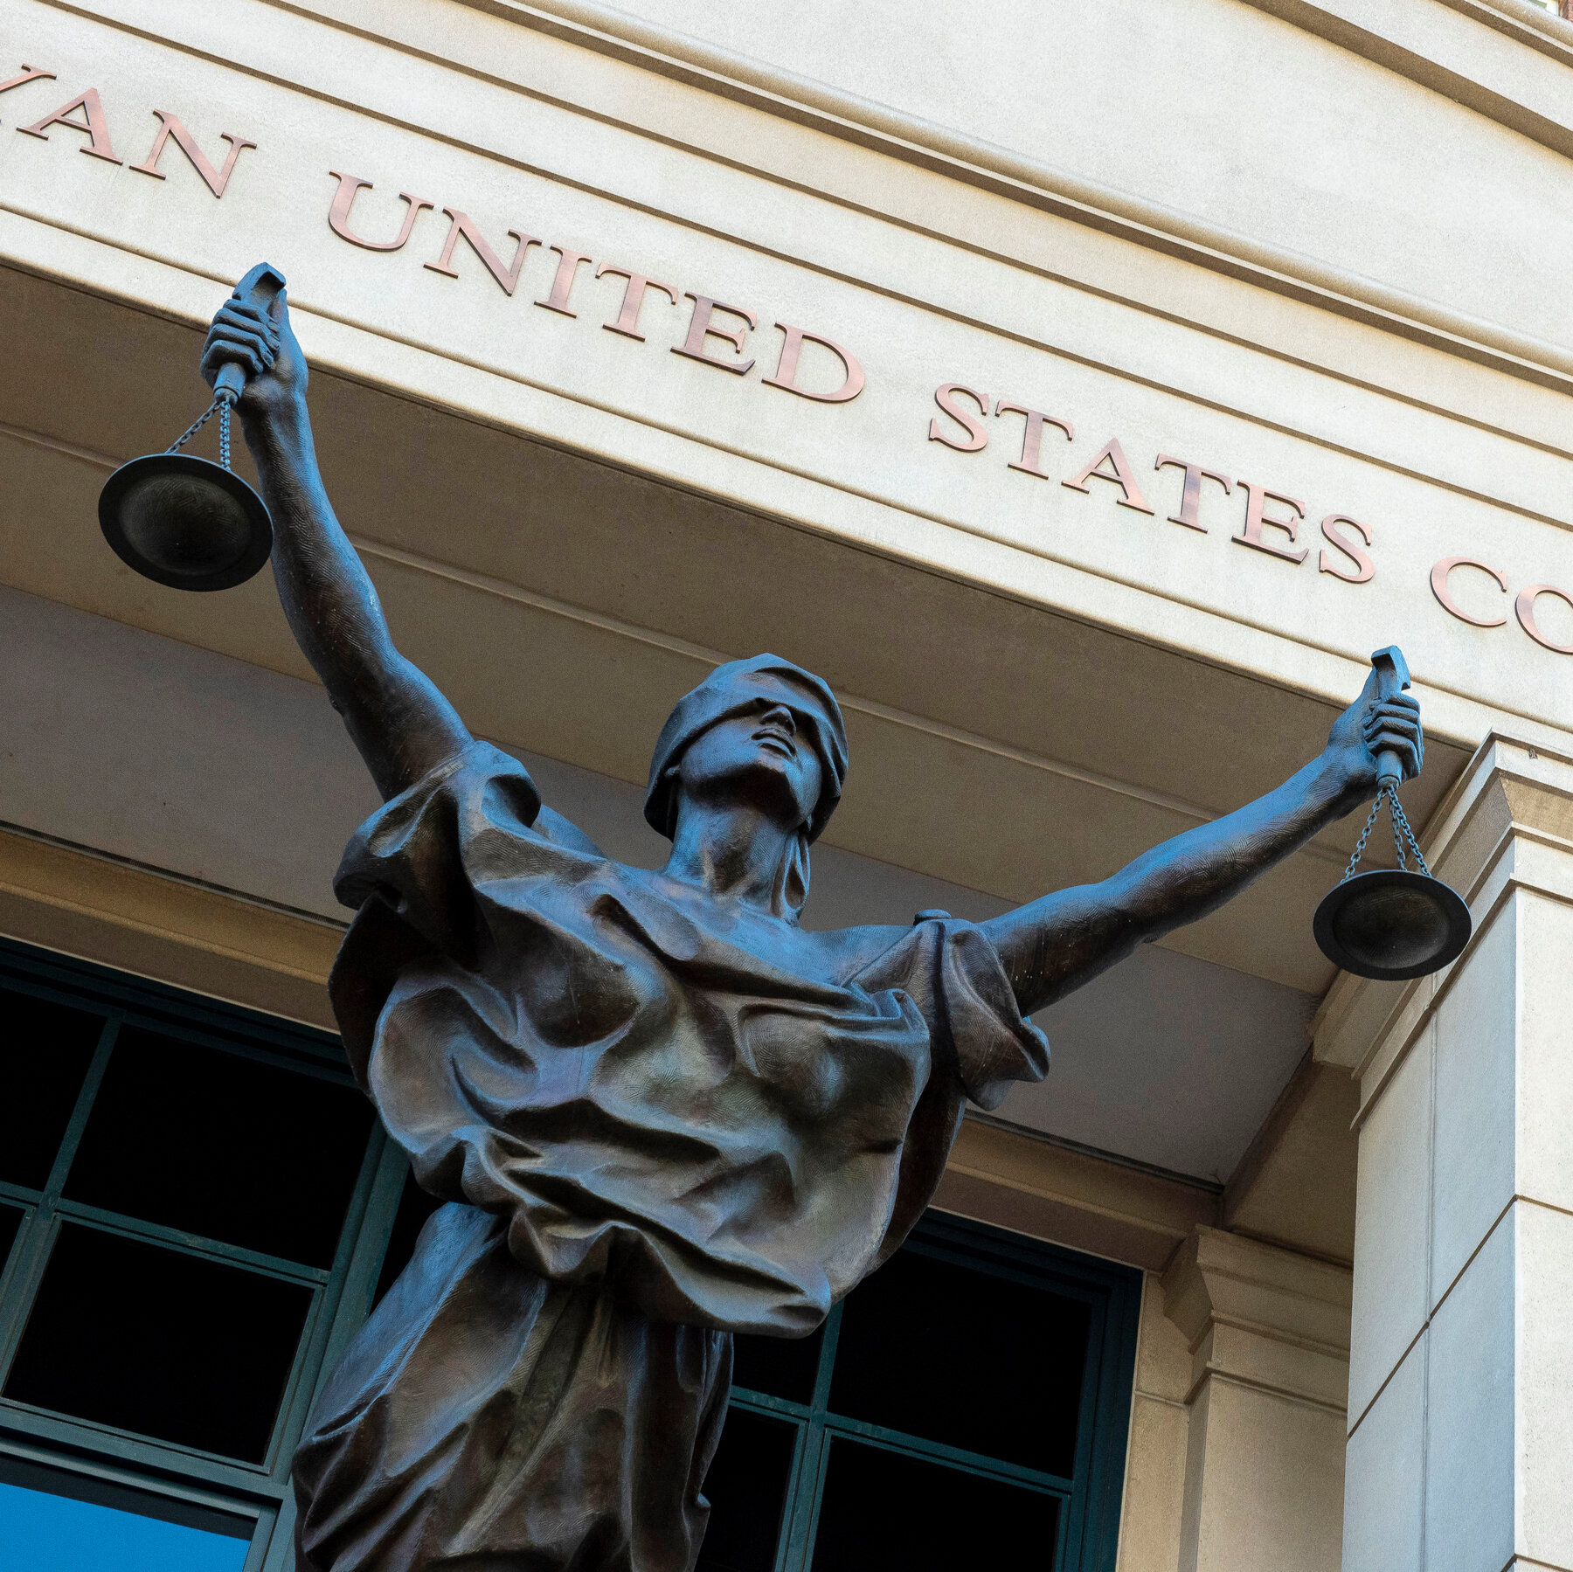
MIRANDA
Custodial Interrogation
and the Two-Step Technique
ACDLA November 3, 2023
David B. Frank
1212 Guadalupe Street, Suite 103
Austin, Texas 78701
Tel. (512) 499-0969
David@DavidFrankLaw.com

Slide 2
What is the Two-steP interrogation technique?
STEP 1: Law Enforcement withholds Miranda warnings until an arrestee confesses, and then
STEP 2: Provides Miranda warnings and elicit a second confession.
Two Statements – Pre-Miranda Stmt and Post-Warning Stmt.

Slide 3
Two-Step Questioning
The intent of this two-step tactic is to obtain a confession before the suspect understands his rights
— then read the suspect his rights
— then have the suspect repeat the confession.¹
Notes:
¹ Martinez v. State, 272 S.W.3d 615, 626 (Tex. Crim. App. 2008).

Slide 4
CASE 1

Slide 5
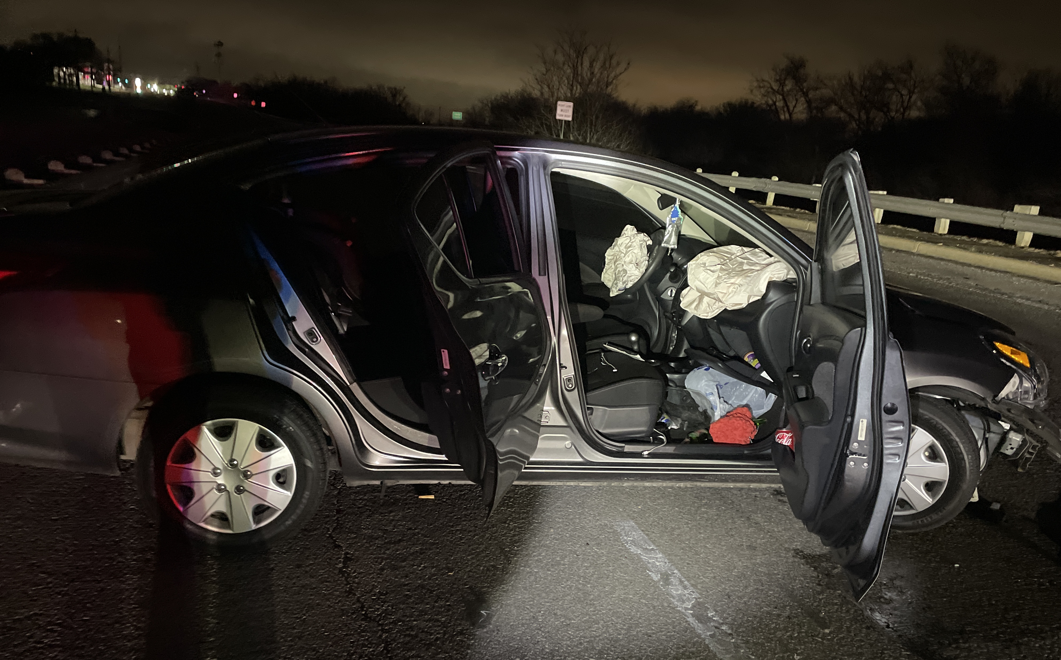
Two-Step Questioning

Slide 6
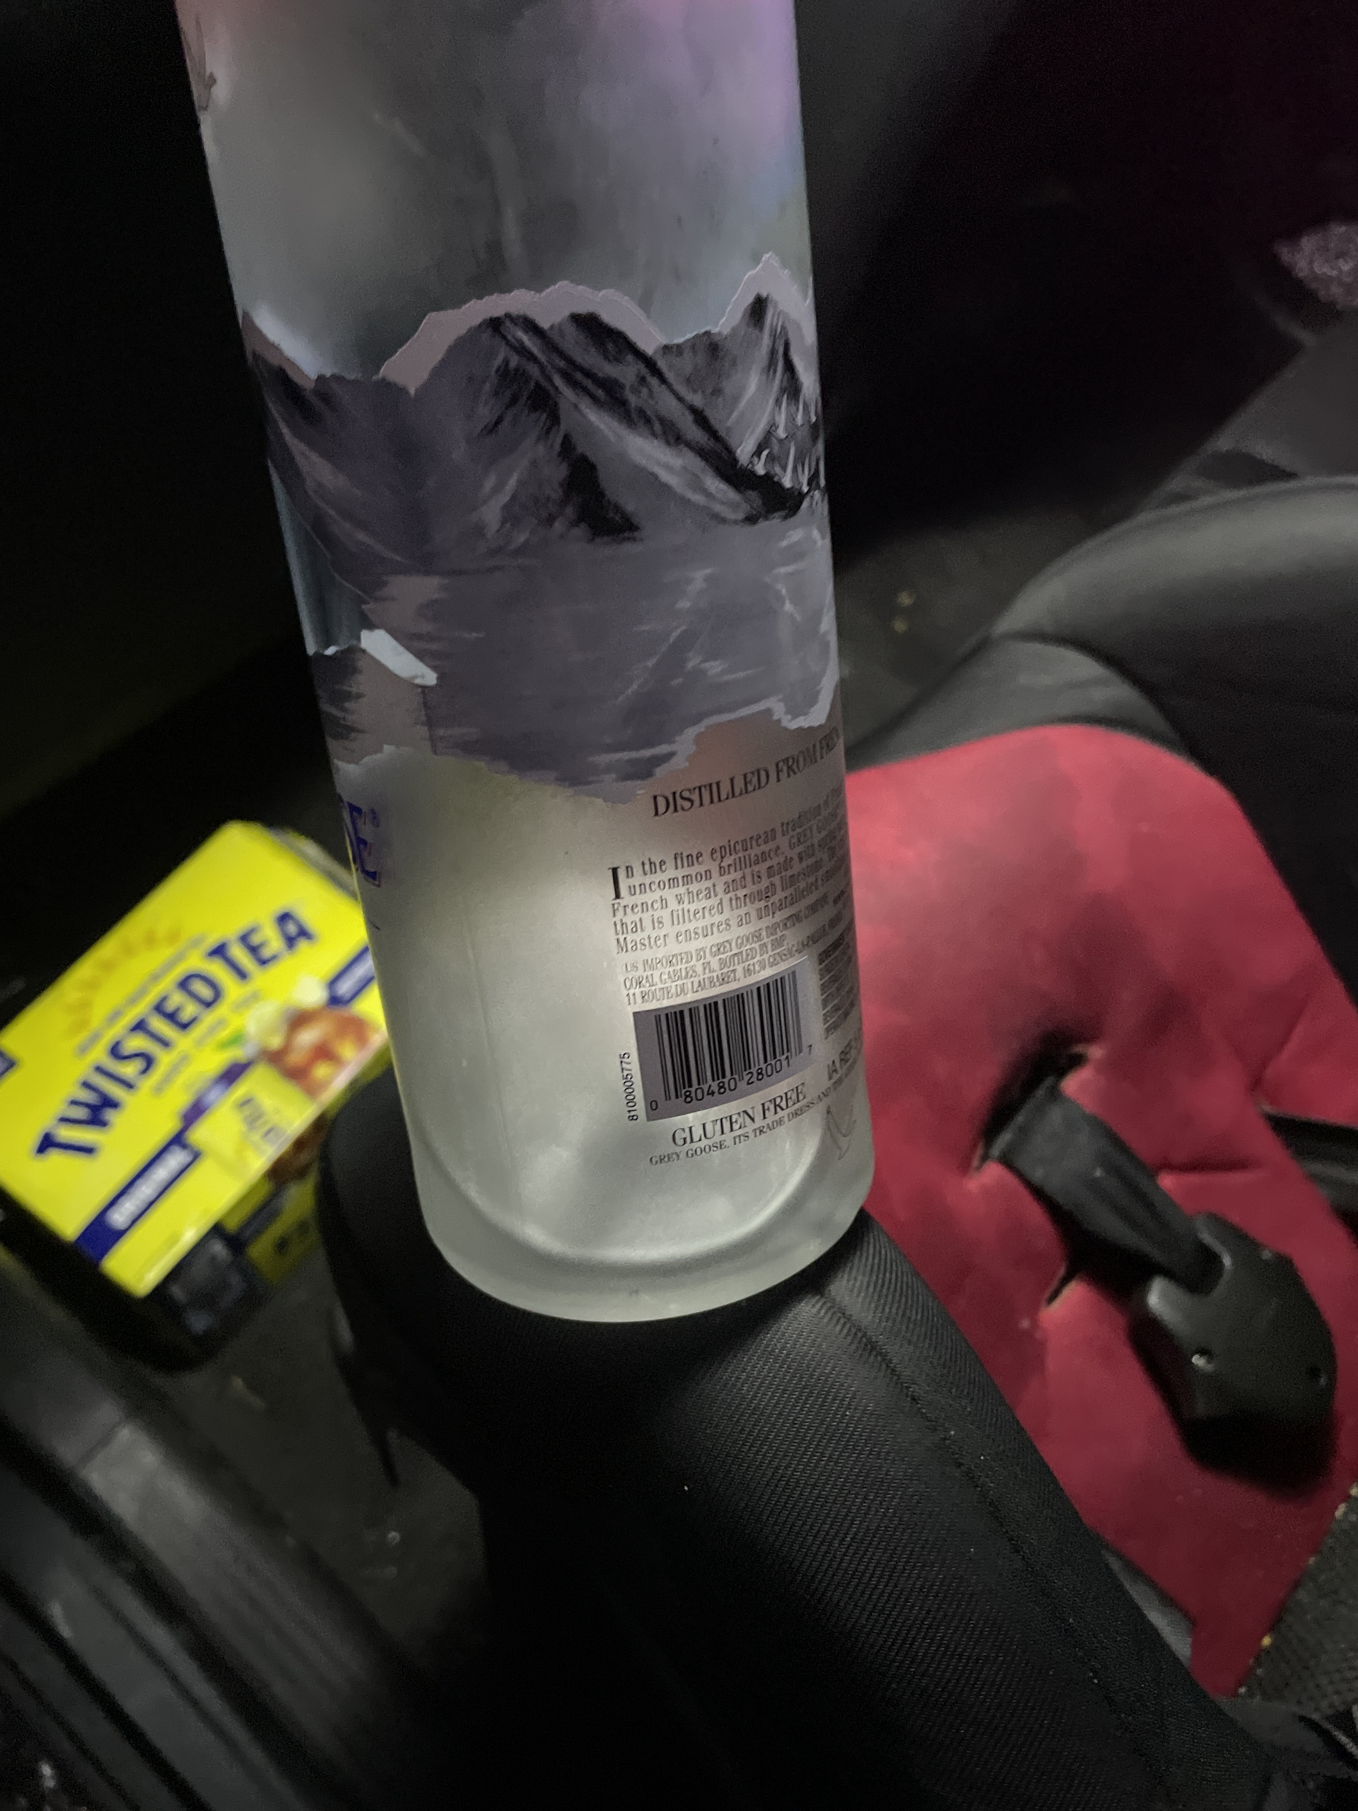
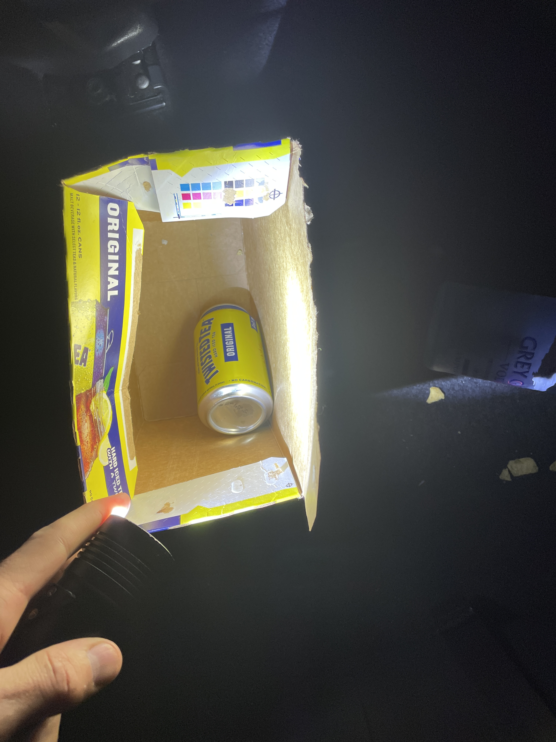
Two-Step Questioning

Slide 7
Two-Step Questioning

Slide 8
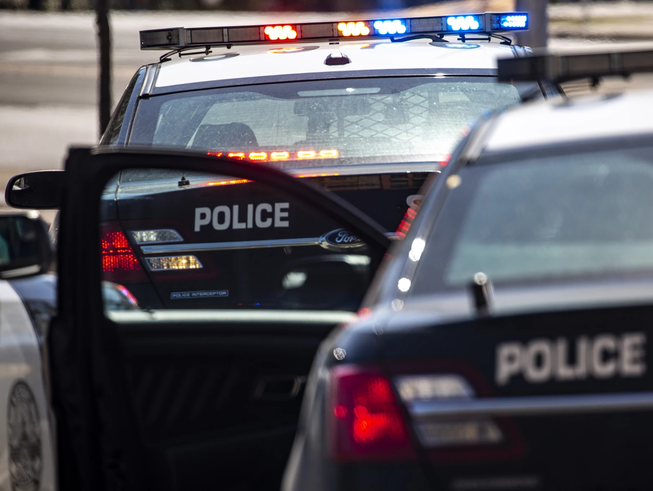
Two-Step Questioning

Slide 9
Two-Step Questioning
D in Patrol Car.
Officers have patted her down. Her wallet is in the front floor board. They take her phone even though she says she wants to use it to text her sister.
[No Miranda Warnings Provided.]
Officer: Who is the guy you’re with?
D: He’s a close friend.
Officer: What happened?
D: I was driving, and I checked my phone because my mom called me … and I just hit the side of the wall.

Slide 10
Two-Step Questioning
[Miranda Warnings Given.]
Officer: Do you understand this?
D: A little bit, A little bit.
Officer: So, what happened? Tell me.
D: I was already driving home….
Officer: How did the wreck happen?
D: I just looked at my phone real quick and then it just happened.

Slide 11
CASE 2

Slide 12
Two-Step Questioning
Trooper sees a white truck change lanes without signaling;
Evading MV;
Trooper never sees the driver;
Truck crashes into a house and the driver flees on foot;

Slide 13
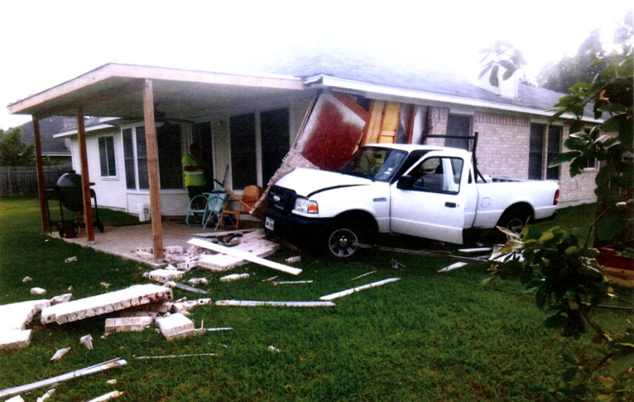
Two-Step Questioning

Slide 14
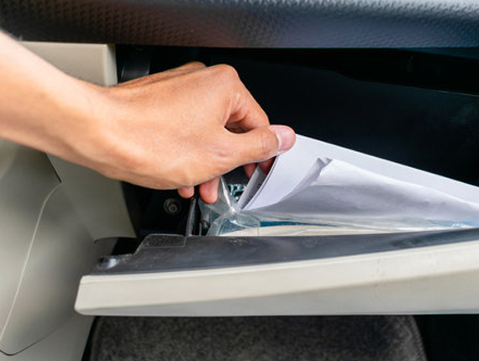
Two-Step Questioning
Officers finds some paperwork in the vehicle and believe it connects the vehicle and the suspect driver;
Driver couldn’t have gone far.

Slide 15
Two-Step Questioning
Police find a suspect 4 miles away…
He generally matches the physical description from the paperwork that was found inside the truck.

Slide 16
Transcript
OFCR: Come here [Suspect’s Name], put your hands on my car. Put your hands on my car.
SUSP: Why?
OFCR: Put your hands on my car. You’re [Suspect’s Name]?
SUSP: Yes.
OFCR: Alright, put your hands on my car. (Searches for weapons)
Put your hands behind your back right here.
60, I show one detained.
Why’d you run man?
SUSP: I don’t know. Scared.
OFCR: You were scared you were going to get in trouble?
SUSP: Yeah.
OFCR: Bro, it was just a car accident?

Slide 17
Custody?
D ordered to put his hands on the car
Placed in handcuffs
Officer reports he has “got him detained.”
Would a reasonable person have —
understood that his detention was no longer likely to be temporary and brief?
believed that his freedom of movement was restrained to the degree associated with a formal arrest?

Slide 18
Two-Step Questioning
Officers talk amongst themselves —
Officers: Did he admit to you that he was driving the car?”
Officer: Oh yeah.

Slide 19
Warnings Given
 | Minutes Later …
Trooper: | I’m gonna read you your rights. You didn’t comply with the requirements, meaning you need to stay there, give your information. So you hit the house and then you left. That’s a class B misdemeanor. Duty on striking a structure, that kind of thing. Class B misdemeanor. The second is you ran on foot. That’s also a misdemeanor.
So here’s what I want to know, why’d you run?

Slide 20
Post-Warning Statement
D was confronted with his pre-warning statement and then made several incriminating admissions during the post warning statement:
He was the driver that evaded in MV,
He ran bc he was scared,
He hit the house,
He ran on foot,
Also made several false statements about evading to avoid consequences.
Then talks about charges and range of punishment.

Slide 21
Two-Step: Was the Suspect in Custody?
Probable cause related by the officers to D i.e., BOLO with offense and description of suspect;
More than one Officer present, guns drawn;
Suspect matched the physical description of the records for the vehicle;
Officers’ knowledge of PC manifested to D (investigating Evading MV and asked “Why’d you run?”;
D had been patted down and handcuffed;
Officers do not tell D that he is free to leave;

Slide 22
Questions Elicited to Obtain an Incriminating Response?
OFCR: Why’d you run man?
SUSP: I don’t know. Scared.
State v. Francis, 228 N.C. App. 569, 749 S.E.2d 110 (2013) State conceded that the statement defendant made to Deputy in response to the officer's question of why defendant ran should be suppressed.
United States v. Austin, No. 2:17-CR-00556-DCN, 2018 WL 3093528, at *4 (D.S.C. June 22, 2018) Officer’s direct questions to appellant of “why did you run” and “do you have drugs on you” fit the definition of interrogation.
State v. Melemai, 64 Haw. 479, 480, 643 P.2d 541, 543 (1982). Officer asked appellant if he had hit anyone with his truck. Appellant answered affirmatively. The officer then asked appellant why he ran away. Appellant responded that he got angry when he saw the jogger and “went for him.” Both questions were asked before Appellant was given Miranda warnings. The trial court granted motion to suppress, ruling that Miranda warnings were required before the police officer could question appellant.
People v Clanton, 151 AD3d 1576, 1578 [4th Dept 2017] After defendant had been restrained and handcuffed, an officer asked him, “[w]hy did you run from the car.” Defendant had been physically restrained and handcuffed after he had fled from an attempted body search.
People v. Roberts (2021) 65 Cal.App.5th 469, 480 [279 Cal.Rptr.3d 878, 889, 65 Cal.App.5th 469, 480], reh'g denied (July 7, 2021), review denied (Sept. 1, 2021). Defendant was clearly in custody at the time he made the statement: he was handcuffed and transferred to a different officer who, without giving a Miranda advisement, asked, “Why did you run?” Asking defendant why he decided to run from police was reasonably likely to produce an incriminating response. Defendant's statement was therefore obtained in violation of Miranda and should not have been admitted.
State v. Leyva, 906 P.2d 894, 898 (Utah Ct. App. 1995), aff'd in part, rev'd in part, 951 P.2d 738 (Utah 1997) Trial court erred in not suppressing defendant's incriminating statements where trooper asked, “So why did you run?” and defendant responded, “The plates are on the wrong car.” Reversed in light of the totality of the circumstances that appellant knowingly and intelligently waived his Miranda rights. State v. Leyva, 951 P.2d 738, 744–45 (Utah 1997).
Finney v. State, 786 N.E.2d 764, 766-67 (Ind. Ct. App. 2003) Trial court abused its discretion in denying Appellant’s motion to strike testimony where after placing appellant into handcuffs and Mirandizing him, officer asked appellant “why did you run?” Appellant responded, “it was a dumb mistake or a stupid mistake.” Court found the question impermissible “police-initiated interrogation.”
Review the cases …

Slide 23
TOPICS
Art. 38.22 Warnings
Custodial Interrogation
Questions Intended to Elicit an Incriminating Response;
Two-Step Interrogation Technique; and
Practical Ideas for Hearings and Trial.
Notes:
We will not be talking about:
Texas Appellate Procedure
Texas Death Penalty
Federal Sentencing Guidelines
Texas Parole Law
Texas Juvenile Law
Municipal and Justice Court Sentencing Procedures
Texas Civil Commitment Procedures
Texas Sex Offender Registration Program
Collateral Consequences

Slide 24
Tex. Crim. Pro. art. 38.22:
Art. 38.22. When statements may be used
Sec. 3(a) No oral or sign language statement of an accused made as a result of custodial interrogation shall be admissible against the accused in a criminal proceeding unless:
(1) …
(2) … the accused is given the [following] warning and the accused knowingly, intelligently, and voluntarily waives any rights set out in the warning; …

Slide 25
WARNINGS Tex. Crim. Pro. art. 38.22:
(1) he has the right to remain silent and not make any statement at all and that any statement he makes may be used against him at his trial;
(2) any statement he makes may be used as evidence against him in court;
(3) he has the right to have a lawyer present to advise him prior to and during any questioning;
(4) if he is unable to employ a lawyer, he has the right to have a lawyer appointed to advise him prior to and during any questioning; and

Slide 26
WARNINGS Tex. Crim. Pro. art. 38.22 Sec. 2(a):
(continued) …
(5) he has the right to terminate the interview at any time; and
(b) the accused, prior to and during the making of the statement, knowingly, intelligently, and voluntarily waived the rights set out in the warning prescribed by Subsection (a) of this section.

Slide 27
Art. 38.22. When statements may be used
Sec. 3. (a) No oral or sign language statement of an accused made as a result of custodial interrogation shall be admissible against the accused in a criminal proceeding unless:
(1) an electronic recording, which may include motion picture, video tape, or other visual recording, is made of the statement;
(2) prior to the statement but during the recording the accused is given the warning in Subsection (a) of Section 2 above and the accused knowingly, intelligently, and voluntarily waives any rights set out in the warning;

Slide 28
Art. 38.22. When statements may be used
Sec. 3. (a) …
(3) the recording device was capable of making an accurate recording, the operator was competent, and the recording is accurate and has not been altered;
(4) all voices on the recording are identified; and

Slide 29
Art. 38.22. When statements may be used
Sec. 3. (a) …
(5) not later than the 20th day before the date of the proceeding, the attorney representing the defendant is provided with a true, complete, and accurate copy of all recordings of the defendant made under this article.

Slide 30
Custody

Slide 31
CUSTODY
“Custody” exists if an officer makes a “formal arrest,” which is accomplished by informing the detainee that he is under “arrest.”¹
A nonarrest field stop for investigation is generally not sufficient,² nor is a “traffic stop” made to issue a citation after which the motorist will be released.³
TEMPORARY DETENTION
Notes:
“In **1529 determining whether an individual was in custody, a court must examine all of the circumstances surrounding the interrogation, but “the ultimate inquiry is simply whether there [was] a ‘formal arrest or restraint on freedom of movement’ of the degree associated with a formal arrest.” Stansbury v. California, 511 U.S. 318, 322, 114 S. Ct. 1526, 1528–29, 128 L. Ed. 2d 293 (1994).
¹ Berkemer v. McCarty, 468 U.S. 420, 441, 104 S. Ct. 3138, 3151, 82 L. Ed. 2d 317 (1984).
² Berkemer at 439
³ Berkemer at 441-42.

Slide 32
Dowthitt: Detention May Become Custodial
Police conduct during an encounter may cause a consensual inquiry to escalate into custodial interrogation.¹
Notes:
¹ Ussery v. State, 651 S.W.2d 767, 770 (Tex.Crim.App.1983).

Slide 33
CUSTODY
Custody may arise if:
Defendant is not free to leave or cannot require the officer to leave, and
The restraint is “comparable to … a formal arrest.”¹
Notes:
¹ Berkemer v. McCarty, 468 U.S. 420 at 441.

Slide 34
Dowthitt v. State, 931 S.W.2d 244 (Tex. Crim. App. 1996).
Capital murder case.
D voluntarily came to the sheriff's office to give a written statement.

Slide 35
Dowthitt: CUSTODY FACTORS CONSIDERED:
• Length of the interrogation (15 hours);
• Exercise of police control over D
accompanying D at restroom breaks and
ignoring requests to see his wife.
• While D did not admit to committing the murder, his damaging admission establishing probable cause that he was present during the murders.
CCA: “Custody” began after D admitted his presence during the murders.
Notes:
Dowthitt v. State, 931 S.W.2d 244, 257 (Tex. Crim. App. 1996).

Slide 36
Dowthitt Timeline
11:00 a.m.
FIRST STATEMENT
D finished and left for lunch. No Miranda Warnings on the statement.
9:00 a.m.
D came to the sheriff's office to give a written statement.
1:00 p.m.
D returned and asked to change his earlier statement because it contained a false alibi.
7:00 p.m.
D told he is not a suspect, D takes polygraph.
Miranda Warnings given. Video 1 starts.
6:00 p.m.
SECOND STATEMENT Detective interrogates D. No Miranda Warnings on the second statement.
11:00 p.m.
Polygraph completed. D asks to speak with his wife. Video 2 starts.
15 hours
1:00 a.m.
Detective told D: “You were there, though, weren’t you?”
Soon after, D says: “I was there the whole time.” He gave details of what he observed at the crime scene, but he did not admit to participation in the murder.
Detective: “Okay? Now, you do realize, and you knew this going in, that you’re not going home tonight. You know that.” D replied, “Yeah. I’ve known that for a long time.”
3:55 a.m.
Third written statement was not electronically recorded, but statements from this interrogation were not admitted into evidence at trial.

Slide 37
Dowthitt v. State, 931 S.W.2d 244 (Tex. Crim. App. 1996).
COMPARABLE TO FORMAL ARREST? Subjective intent of the police and the defendant that custody occurred is irrelevant.
At least four general situations which may constitute custody:
(1) when the suspect is physically deprived of his freedom of action in any significant way,
(2) when a law enforcement officer tells the suspect that he cannot leave,
(3) when law enforcement officers create a situation that would lead a reasonable person to believe that his freedom of movement has been significantly restricted, and
Notes:
Stansbury, 511 U.S. at 323, 114 S.Ct. 1526. The following situations may constitute custody: (1) when the suspect is physically deprived of his freedom of action in any significant way, (2) when a law-enforcement officer tells the subject he cannot leave, (3) when law-enforcement officers create a situation that would lead a reasonable person to believe that his freedom of movement has been significantly restricted, or (4) when there is probable cause to arrest and law-enforcement officers do not tell the suspect he is free to leave. Id. at 323–25, 114 S.Ct. 1526; Shiflet, 732 S.W.2d at 629.

Slide 38
Dowthitt: PROBABLE CAUSE TO ARREST
(4) when there is probable cause to arrest and law enforcement officials do not tell the suspect that he is free to leave.
The requirement is that probable cause be manifested to the suspect.
Notes:
This can occur if information substantiating probable cause is related by the officers to the suspect or by the suspect to the officers.
Custody is established if the manifestation of probable cause, combined with other circumstances, would lead a reasonable person to believe that he is under restraint to the degree associated with an arrest.

Slide 39
Dowthitt: PROBABLE CAUSE TO ARREST
… we will analyze the issue from a federal constitutional perspective and presume that the state law standard is the same.

Slide 40
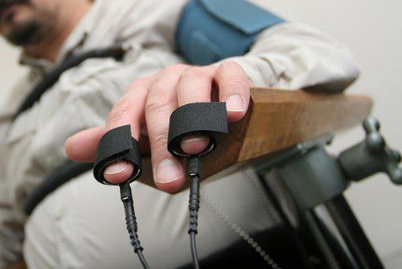
Dowthitt: CUSTODY FACTORS CASE SPECIFIC:
The determination of custody must be made on an ad hoc basis, after considering all of the (objective) circumstances.
Stationhouse questioning does not, in and of itself, constitute custody.¹
Custody does not occur merely because the suspect submits to and fails a polygraph test.²
The use of handcuffs does not necessarily constitute arrest or custody.³
Notes:
¹ California v. Beheler, 463 U.S. 1121, 1124–1125, 103 S.Ct. 3517, 3519–3520, 77 L.Ed.2d 1275 (1983.) Oregon v. Mathiason, 429 U.S. 492, 495, 97 S.Ct. 711, 714, 50 L.Ed.2d 714 (1977). Dancy, 728 S.W.2d at 778. See also Russell v. State, 717 S.W.2d 7, 11 (Tex.Crim.App.1986). Further,
² Shiflet v. State, 732 S.W.2d 622, 631 (Tex.Crim.App.1985), Stone v. State, 583 S.W.2d 410, 413 (Tex.Crim.App.1979).
³ Rhodes v. State, 945 S.W.2d 115, 117 (Tex. Crim. App. 1997) (refusing to adopt bright-line test providing that “mere handcuffing is always the equivalent of an arrest”).

Slide 41
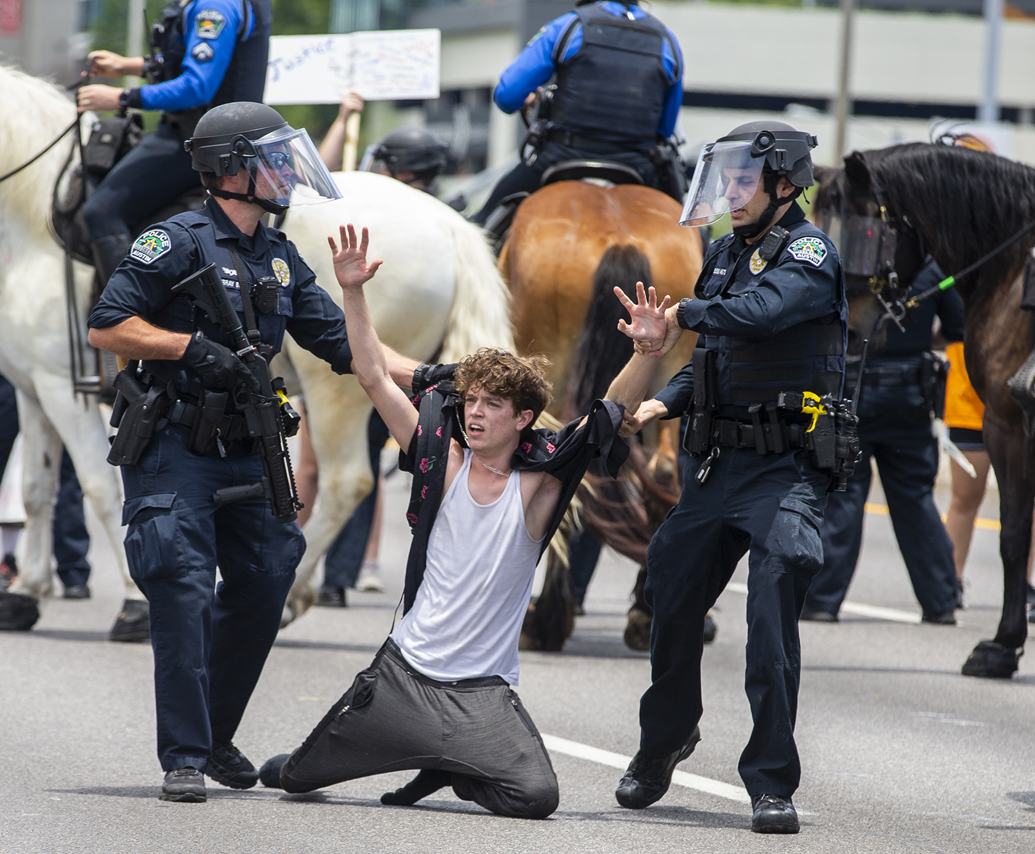
Other Factors might Support Custody:
Whether the officer actually conducts an investigation after seizing the suspect.
Notes:
The degree of force employed by a police officer;¹
The nature of the crime under investigation,
the degree of suspicion,
the location of the stop,
the time of day, and the
reaction of the suspect;²
The officer’s opinion;³
¹ State v. Moore, 25 S.W.3d 383, 386 (Tex. App. - Austin 2000, no pet.).
² See id. (citing 4 Wayne R. LaFave, Search and Seizure § 9.2(d) (3d ed. 1996)).
³ See id. (citing Amores v. State, 816 S.W.2d 407, 412 (Tex. Crim. App.1991)); see also Rhodes v. State, 913 S.W.2d 242, 247 (Tex. App. - Fort Worth 1995), aff'd, 945 S.W.2d 115 (Tex. Crim. App. 1997).
⁴ See Amores, 816 S.W.2d at 412; see also Rhodes, 945 S.W.2d at 119–20 (Meyers, J., concurring and dissenting) (discussing the differences between an arrest and an investigatory stop). Whether a seizure is an actual arrest or an investigative detention depends on the reasonableness of the intrusion under all of the facts. Morris v. State, 50 S.W.3d 89, 95 (Tex. App. - Fort Worth 2001, no pet.).

Slide 42
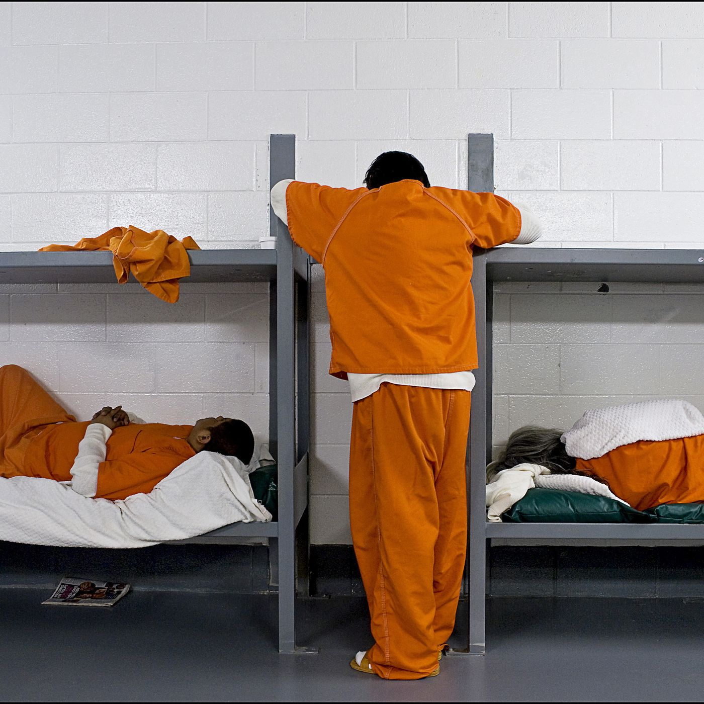
Incarceration is not Custody
The fact that a suspect is already incarcerated does not necessarily mean the suspect is in custody when approached by law enforcement “regarding an offense separate and distinct from the offense for which he was incarcerated.¹
Notes:
¹ Herrera v. State, 241 S.W.3d 520 (Tex. Crim. App. 2007).

Slide 43
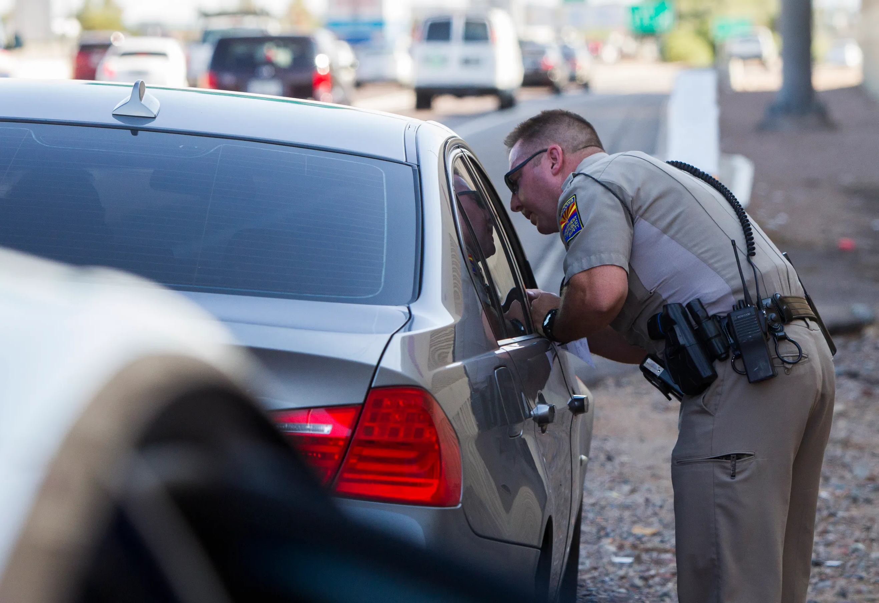
State v. Ortiz, 382 S.W.3d 367, 373 (Tex. Crim. App. 2012)
No more than 10 minutes into the stop, Officer expressly accused D of having drugs.
D Stopped for speeding 13 mph over limit;
After asking for license and insurance, Officer asked D to step out of the car and move to Officer's patrol car;
Notes:
State v. Ortiz, 382 S.W.3d 367, 373 (Tex. Crim. App. 2012).

Slide 44
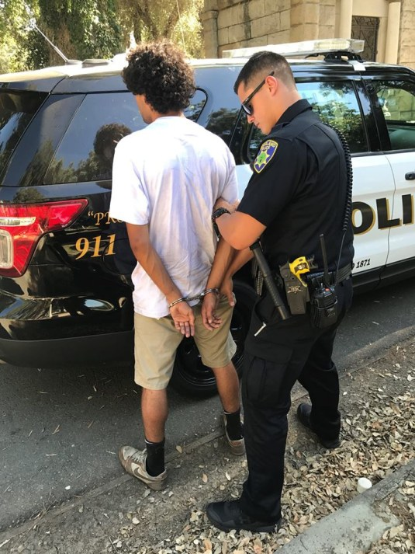
State v. Ortiz, 382 S.W.3d 367, 373 (Tex. Crim. App. 2012)
Officer questioned D;
D revealed that he was going, with his wife to Spearman, Texas;
D stated that he was on probation in Spearman “for drugs”;

Slide 45
State v. Ortiz, 382 S.W.3d 367, 373 (Tex. Crim. App. 2012)
Officer asked D point-blank¹ “How much drugs are in the car?”
D responded “No. No. No. No.”
D then consented to a search of his person and his car;
Notes:
¹ Officer almost instantly accused suspect of drug possession. See, State v. Saenz, 411 S.W.3d 488, 498 (Tex. Crim. App. 2013).

Slide 46
State v. Ortiz, 382 S.W.3d 367, 373 (Tex. Crim. App. 2012)
Two back up officers arrived;
Officers pat down D’s wife and put her in handcuffs;
They discover drugs during the wife’s patdown.

Slide 47
State v. Ortiz, 382 S.W.3d 367, 373 (Tex. Crim. App. 2012)
Officer said to D, “Yep. Turn around. Put your hands behind your back.” D handcuffed.
Officer asked D, “What kind of drugs does your wife have?”
D responded, cocaine.
POCS > 400 grams of cocaine;

Slide 48
State v. Ortiz, 382 S.W.3d 367, 373 (Tex. Crim. App. 2012)
D files Motion to Suppress statements;
At the MTS hearing, the State called only the arresting officer;
During the officer’s testimony, the State admitted a video of the stop.

Slide 49
State v. Ortiz, 382 S.W.3d 367, 373 (Tex. Crim. App. 2012)
The trial court:
MOTION TO SUPPRESS GRANTED,
By the time he was placed in handcuffs, D was arrested and in custody for Miranda purposes.

Slide 50
State v. Ortiz, 382 S.W.3d 367, 373 (Tex. Crim. App. 2012)
Arresting Officer had expressed his suspicion to D “Point Blank” that D had drugs in his possession;
(2) Two additional officers had arrived on the scene;
(3) D’s wife and D had both been patted down and handcuffed; and
(4) The officers had manifested their belief to D that he was connected to some sort of illegal or dangerous activity on the part of his wife.
D was in custody. These circumstances combined to lead a reasonable person to believe that D’s liberty was compromised to a degree associated with formal arrest.

Slide 51
Xu v. State, 100 S.W.3d 408, 412–13 (Tex. App.—San Antonio 2002, pet. ref’d):
Murder Investigation
D was told that his wife was strangled to death.
He then made the pivotal admission:
“I grabbed her by the throat. I was so mad I don't know how hard I squeezed.”

Slide 52
Xu v. State, 100 S.W.3d 408, 412–13 (Tex. App.—San Antonio 2002, pet. ref’d):
Interrogation is not custodial when a person voluntarily …
accompanies the police to the station, undergoes a thirty-minute interview, and leaves—regardless of whether the person is informed that he is not under arrest.¹
arrives at the station at a time of his choosing, is allowed to step outside the building and go unaccompanied to his car during the interviews that lasted several hours, and is allowed to leave unhindered after the statements are taken.²
Notes:
¹ Dowthitt v. State, 931 S.W.2d 244, 255 (Tex.Crim.App.1996 (citing California v. Beheler, 463 U.S. 1121, 103 S.Ct. 3517, 77 L.Ed.2d 1275 (1983) and Oregon v. Mathiason, 429 U.S. 492, 97 S.Ct. 711, 50 L.Ed.2d 714 (1977)).
² Dowthitt, 931 S.W.2d at 255 (citing Meek v. State, 790 S.W.2d 618 (Tex.Crim.App.1990)).

Slide 53
Xu v. State, 100 S.W.3d 408, 412–13 (Tex. App.—San Antonio 2002, pet. ref’d):
But see Xu …
D was in custody from the moment he made his “pivotal admission,” even though he was not formally arrested until some time later.

Slide 54
Xu v. State, 100 S.W.3d 408, 412–13 (Tex. App.—San Antonio 2002, pet. ref’d):
Factors when custody attaches include:
(1) whether the suspect arrived at the place of interrogation voluntarily;
(2) the length of the interrogation;
(3) whether the suspect's requests to see relatives and friends were refused;
(4) the degree of control exercised over the suspect; and
(5) whether a “pivotal admission” established probable cause.

Slide 55
Xu v. State, 100 S.W.3d 408, 412–13 (Tex. App.—San Antonio 2002, pet. ref’d):
(1) Arrived Voluntarily
D voluntarily submitted to questioning, but he was in a distraught emotional and physical state (his wife had died and he was sobbing);
He was born in China, where there are no Miranda rights; and
He spoke little English;
(2) Length of Interrogation
D had been interrogated by multiple officers;
During separate interviews;
Over the course of 18 hours and
Had been at the police station for 5 hours before making his pivotal admission;

Slide 56
Xu v. State, 100 S.W.3d 408, 412–13 (Tex. App.—San Antonio 2002, pet. ref’d):
(3) Requests to see relatives and friends were refused
D’s friend tried to see and speak with D but was not permitted to do so;
(4) The degree of control exercised over the suspect
D had not been told that he was free to leave for approximately five hours before his pivotal admission;
He received only one bottle of water; and
One restroom break during that time;

Slide 57
Xu v. State, 100 S.W.3d 408, 412–13 (Tex. App.—San Antonio 2002, pet. ref’d):
(5) whether a “pivotal admission” established probable cause
D made a pivotal admission in the second interview,;
Shortly after the Detective told D that he believed D had murdered his wife; and
That the Detective did not believe his story;
OTHER FACTORS:
D was informed at the beginning of his first interview at the station that he was free to leave but not again in his second interview five hours later when he made his pivotal admission;

Slide 58
Xu v. State, 100 S.W.3d 408, 412–13 (Tex. App.—San Antonio 2002, pet. ref’d):
(7) the evidence suggested D was permitted to leave the police station and not formally arrested after the interrogation not because he was not in custody but because the police wanted to avoid compliance with article 38.22.

Slide 59
Xu v. State, 100 S.W.3d 408, 412–13 (Tex. App.—San Antonio 2002, pet. ref’d):
Appellant argued the trial court erred in denying his motion to suppress because his statement was taken in violation of:
The Fifth, Sixth, and Fourteenth Amendments to the United States Constitution;
Article I, section 10 of the Texas Constitution; and
Articles 38.22 and 38.23 of the Texas Code of Criminal Procedure.
Court: We agree.

Slide 60
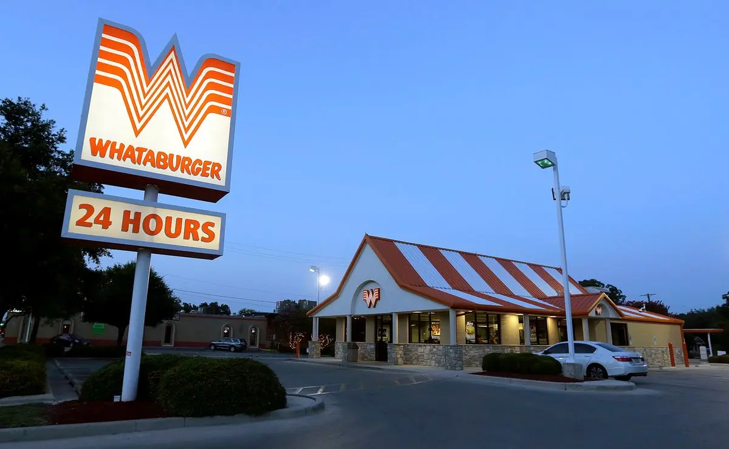
State v. Saenz

Slide 61
State v. Saenz
State v. Saenz, 2012 WL 7783406, Tex. App.-Corpus Christi, Dec. 28, 2012;
Judgment reversed by State v. Saenz, 411 S.W.3d 488, Tex. Crim. App. 2013;
On remand to State v. Saenz, 2014 WL 3542092, Tex. App.-Corpus Christi, July 17, 2014 (mem. op., not designated for publication), PDR ref’d Oct 08, 2014.
Notes:
The court of criminal appeals remanded the cause to this Court for abatement to the trial court for more complete findings of fact. Id. at 498. In light of the trial court's supplemental findings of fact, we hereby reinstate the appeal and affirm the trial court's judgment. State v. Saenz, No. 13-11-00328-CR, 2014 WL 3542092, at *1 (Tex. App.—Corpus Christi–Edinburg July 17, 2014, pet. ref’d).

Slide 62
State v. Saenz
Timing isn’t everything …
12-18 minute DWI detention becomes “custody”.
Notes:
¹ State v. Saenz, No. 13-11-00328-CR, 2012 WL 7783406, at *1 (Tex. App.—Corpus Christi–Edinburg Dec. 28, 2012), rev'd, 411 S.W.3d 488 (Tex. Crim. App. 2013).
² Id.

Slide 63
State v. Saenz
Whataburger … two intoxicated men were trying to start a fight.
D and his passenger match the descriptions.
D sitting in his truck, parked across two handicapped parking spaces, engine running, reverse lights on.
Patrol Officer told D on 3 occasions to turn off his vehicle;
Notes:
¹ State v. Saenz, No. 13-11-00328-CR, 2012 WL 7783406, at *1 (Tex. App.—Corpus Christi–Edinburg Dec. 28, 2012), rev'd, 411 S.W.3d 488 (Tex. Crim. App. 2013).
² Id.

Slide 64
State v. Saenz
D finally shuts off the truck and Patrol Officer removes D from vehicle;
No Handcuffs;
D waits in the backseat of the patrol car for 12–18 minutes before interrogation;
Patrol car locked and D could not leave;¹
No Miranda Warnings Officer asked D:
where he had been,
how he arrived at the Whataburger,
how much alcohol he had been consuming,
where he was consuming alcohol, and
how long he had been drinking.
Notes:
¹ State v. Saenz, No. 13-11-00328-CR, 2012 WL 7783406, at *1 (Tex. App.—Corpus Christi–Edinburg Dec. 28, 2012), rev'd, 411 S.W.3d 488 (Tex. Crim. App. 2013).
See, State v. Leon, No. 08-15-00365-CR, 2017 WL 696127, at *4 (Tex. App.—El Paso Feb. 22, 2017, pet. ref’d) for a brief discussion about restraining someone in the backseat of patrol car: “the State does not argue that placing Leon in the back of the car was necessary to effectuate some investigatory or law enforcement purpose, nor can we independently discern any reason such as officer safety or flight risk that would justify the restraint, as the State never once asked why placing Leon in the cruiser was necessary.” If the State argues D was placed in backseat ”to effect the goal of the detention: investigation, maintenance of the status quo, or officer safety,” then the seizure might be more of a temporary detention than an arrest.

Slide 65
State v. Saenz
COURT:
Officers' actions escalated the temporary detention to an arrest.
D was in custody at the time he was placed in the back of the patrol car.
D responds that he had six beers in four hours.¹
Notes:
¹ State v. Saenz, No. 13-11-00328-CR, 2012 WL 7783406, at *1 (Tex. App.—Corpus Christi–Edinburg Dec. 28, 2012), rev'd, 411 S.W.3d 488 (Tex. Crim. App. 2013).
Officer Bintliff's manifestation of his intent to arrest Mr. Saenz was made when he physically placed Mr. Saenz in his police car and verbally told him not to leave. State v. Saenz, No. 13-11-00328-CR, 2014 WL 3542092, at *3 (Tex. App.—Corpus Christi–Edinburg July 17, 2014, pet. ref’d)

Slide 66
State v. Saenz
D “was never told that he was not under arrest”
and trial court “did not explicitly find that Saenz was told that the reason he had to wait was so that officers could continue investigating.”
Record was ambiguous as to whether D was told that the reason he had to wait was so that officers could continue investigating.
Notes:
¹ State v. Saenz, No. 13-11-00328-CR, 2012 WL 7783406, at *1 (Tex. App.—Corpus Christi–Edinburg Dec. 28, 2012), rev'd, 411 S.W.3d 488 (Tex. Crim. App. 2013).
² Id.

Slide 67
State v. Saenz
For the foregoing reasons, the trial court did not abuse its discretion in concluding that D was in custody at the time he made the statements or in suppressing those statements.
Notes:
¹ State v. Saenz, No. 13-11-00328-CR, 2012 WL 7783406, at *1 (Tex. App.—Corpus Christi–Edinburg Dec. 28, 2012), rev'd, 411 S.W.3d 488 (Tex. Crim. App. 2013).
Accord, State v. Leon, No. 08-15-00365-CR, 2017 WL 696127, at *4 (Tex. App.—El Paso Feb. 22, 2017, pet. ref’d).

Slide 68
INTERROGATION

Slide 69
Reasonably Likely to Elicit an Incriminating Response.
Volunteered statements are not barred by the Fifth Amendment. Miranda v. Arizona, 384 U.S. 436, 478, 86 S. Ct. 1602, 1630, 16 L. Ed. 2d 694 (1966).

Slide 70
Reasonably Likely to Elicit an Incriminating Response.
Miranda comes into play whenever a person in custody is subjected to either —
Express Questioning or
its Functional Equivalent.
“Interrogation” refers to any words or actions that the police should know are reasonably likely to elicit an incriminating response from the suspect.¹
Notes:
1 Rhode Island v. Innis, 446 U.S. 291, 300-01, 100 S. Ct. 1682, 1689, 64 L. Ed. 2d 297 (1980).
The suspect in Innis had been arrested for robbing a cab driver with a sawed-off shotgun. When apprehended, however, the suspect was unarmed. At the time of the arrest, the police immediately read the suspect his Miranda rights and the suspect responded that he understood his rights and wished to speak with an attorney. A police captain instructed three patrolmen to transport the suspect to the police station and admonished them not to question or coerce the suspect in any way. During the trip, however, the officers conversed with each other about the possibility of a handicapped child finding the shotgun and killing herself. The suspect then interrupted and led the patrolmen to the gun.

Slide 71
Reasonably Likely to Elicit an Incriminating Response.
Not “interrogation.”
Routine inquiries,
Questions incident to booking,
Broad general questions such as “what happened” upon arrival at the scene of a crime,
Questions mandated by public safety concerns e.g. “where did you hide the weapon” when the weapon has just been hidden in the immediate vicinity.¹
Notes:
¹ Ortiz, 346 S.W.3d at 134–35 (citing Jones, 795 S.W.2d at 174 n.3); Jones v. State, 795 S.W.2d 171, 174 (Tex. Crim. App. 1990) citing Ringel, SEARCHES AND SEIZURES, ARRESTS AND CONFESSIONS, Sec. 27.4 (Clark Boardman Company, Ltd. 1987).

Slide 72
Reasonably Likely to Elicit an Incriminating Response.
Not “interrogation.”
Asking a suspect —
Whether he will take a blood alcohol test or repeatedly asking a suspect to give a breath sample.¹
“Where are you going?”²
Where’s the murder weapon.³
Notes:
¹ McCambridge v. State, 712 S.W.2d 499 (Tex.Cr.App.1986) (remanded on other grounds); see McCambridge v. State, 778 S.W.2d 70 (Tex.Cr.App.1989) (affirmed on other grounds) (blood test).
2 Massie v. State, 744 S.W.2d 314 (Tex.App.—Dallas 1988, pet. ref’d.)
³ DeLeon v. State, 758 S.W.2d 621 (Tex.App.—Houston [14th Dist.] 1988, no pet.)

Slide 73
official law enforcement interrogation
Article 38.22 does not apply to non-law enforcement personnel who are not state agents.¹
Notes:
¹ Escamilla v. State, 143 S.W.3d 814, 822 (Tex. Crim. App. 2004).

Slide 74
official law enforcement interrogation
So … Not State Agents:
Television reporter who interviewed defendant in jail at the behest of the police.¹
Doctors and nurses, to whom defendant made incriminating statements while being treated at hospital.²
Notes:
¹ Escamilla v. State, 143 S.W.3d 814, 822 (Tex. Crim. App. 2004).
² Id.
³ State v. Hernandez, 842 S.W.2d 306, 312–16 (Tex. App. - San Antonio 1992, pet. ref'd), cert. denied, 509 U.S. 927, 113 S.Ct. 3049, 125 L.Ed.2d 733 (1993) (thorough discussion of how non-law enforcement personnel can become state agents for Sixth Amendment purposes).
⁴ Hernandez at 314.

Slide 75
official law enforcement interrogation
Wilkerson v. State, 173 S.W.3d 521, 523–24 (Tex. Crim. App. 2005)
CPS investigator met with D at the county jail.
She interviewed D and asked him about the marks on his son.
D told CPS that he had spanked his son several times.
The jury convicted D of causing serious bodily injury of a child.
Assessed punishment at 30 years' imprisonment

Slide 76
official law enforcement interrogation
Wilkerson v. State, 173 S.W.3d 521, 523–24 (Tex. Crim. App. 2005)
When a state-agency employee is working on a path parallel to, yet separate from, the police, Miranda warnings are not required.

Slide 77
official law enforcement interrogation
Wilkerson v. State, 173 S.W.3d 521, 523–24 (Tex. Crim. App. 2005)
Only when a CPS investigator (or other non-law enforcement state agent) is acting in tandem with police to investigate and gather evidence for a criminal prosecution are such warnings required.
CPS caseworker,
Teacher,
Preacher,
Probation officer, or
Mere family friend
Notes:
¹ Lopez v. State, 582 S.W.3d 377 (Tex. App.—San Antonio 2018, pet. ref’d).

Slide 78
official law enforcement interrogation
CPS investigator was not an agent —
CPS and police investigations were separate and distinct;
CPS investigator's presence at the police department was not at the behest of law enforcement;
The interview was not arranged by the police;
The police not present during the interview;
Police did not provide CPS investigator with questions to ask or information to be obtained.
Notes:
¹ Lopez v. State, 582 S.W.3d 377 (Tex. App.—San Antonio 2018, pet. ref’d).

Slide 79
INFORMANTS
But …
It is interrogation where the police employ an informant to deliberately elicit incriminating statements from an in-custody defendant.¹
Agency between law enforcement and non-law enforcement personnel depends upon the existence of an agreement at the time of the elicitation.²
Notes:
¹ State v. Hernandez, 842 S.W.2d 306, 312–16 (Tex. App. - San Antonio 1992, pet. ref'd), cert. denied, 509 U.S. 927, 113 S.Ct. 3049, 125 L.Ed.2d 733 (1993) (thorough discussion of how non-law enforcement personnel can become state agents for Sixth Amendment purposes).
² Hernandez at 314.

Slide 80
TWO-STEP QUESTIONING
Question First, Warn Later

Slide 81
Two-Step Questioning
If the police —
1. Question the suspect first,
2. Then give Miranda warnings,
— they have engaged in a “two-step” or “question first, warn later” interrogation.¹
Notes:
¹ Missouri v. Seibert, 542 U.S. 600, 611, 124 S.Ct. 2601, 2609, 159 L.Ed2d 643 (2004); Martinez v. State, 272 S.W.3d 615, 626 (Tex. Crim. App. 2008).

Slide 82
Two-Step Questioning Missouri v. Seibert, 124 S.Ct. 2601 (2004)
The Court concluded that a “question first, warn later” interrogation technique circumvented the objective of Miranda by rendering any warnings given ineffective.¹
Notes:
¹ Missouri v. Seibert, 542 U.S. at 611–13, 124 S.Ct. 2601; see also Martinez v. State, at 619–20.

Slide 83
Two-Step Questioning Missouri v. Seibert, 124 S.Ct. 2601 (2004)
Murder Case.
Rolla, Missouri P.D. made a “conscious decision” to withhold Miranda warnings.
Officer questioned D for 30 to 40 minutes.
Pre-Miranda Stmt: Seibert admitts she knew her son was meant to die in a house fire.
Officer gave D a 20–minute break. Then gave Miranda warnings, obtained a signed waiver, and confronted D with her pre-Miranda statement.
Post-Warning Stmt: Seibert again confesses.
“Largely a repeat of information obtained” pre-Miranda.
… “didn't you tell me that he was supposed to die in his sleep?”

Slide 84
Two-Step Questioning Missouri v. Seibert, 124 S.Ct. 2601 (2004)
The Seibert plurality found that the purpose of this interrogation technique was to obtain a confession the suspect may not have made if she had understood her rights at the outset.¹
Notes:
¹ Seibert, 542 U.S. at 611, 124 S.Ct. 2601.

Slide 85
Two-Step Questioning Missouri v. Seibert, 124 S.Ct. 2601 (2004)
Five factors to be weighed when analyzing the effectiveness of the warning:
(1) the completeness and detail of the questions and answers in the first round of interrogation,
(2) the overlapping content of the two statements,
(3) the timing and setting of the first and second interrogation,
(4) the continuity of police personnel, and
(5) the degree to which the interrogator's questions treated the second round as continuous with the first.
Notes:
Id. at 615, 124 S.Ct. 2601.

Slide 86
Two-Step Questioning Missouri v. Seibert, 124 S.Ct. 2601 (2004)
Concurrence:
When a two-step interrogation technique is used …
in a deliberate, calculated way to undermine Miranda warnings, …
absent “curative measures,” the post-warning statements must be excluded.¹
Notes:
¹ Seibert, 542 U.S. at 622, 124 S.Ct. 2601 (Kennedy, J., concurring).
² In Carter v. State, the Court of Criminal Appeals expressly adopted Justice Kennedy's concurrence in Seibert. Carter v. State, 309 S.W.3d 31, 38 (Tex. Crim. App. 2010).

Slide 87
Two-Step Questioning Missouri v. Seibert, 124 S.Ct. 2601 (2004)
Concurrence:
When a two-step interrogation technique is used …
in a deliberate, calculated way to undermine Miranda warnings, …
absent “curative measures,” the post-warning statements must be excluded.¹
Notes:
¹ Seibert, 542 U.S. at 622, 124 S.Ct. 2601 (Kennedy, J., concurring).
² In Carter v. State, the Court of Criminal Appeals expressly adopted Justice Kennedy's concurrence in Seibert. Carter v. State, 309 S.W.3d 31, 38 (Tex. Crim. App. 2010).

Slide 88
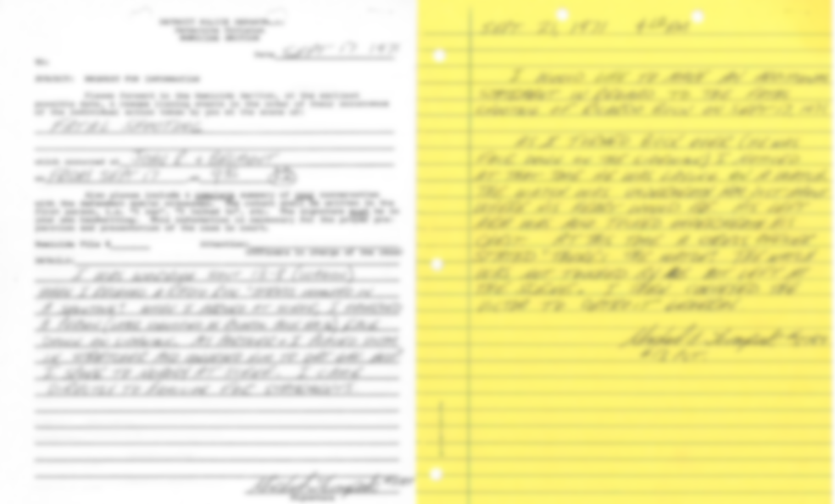
Two-Step Questioning Missouri v. Seibert, 124 S.Ct. 2601 (2004)
Curative Measures such as:
(1) Substantial break in time btn stmts;
(2) Explaining that the unwarned statements are likely inadmissible;
X
Notes:
¹ Seibert, 542 U.S. at 622, 124 S.Ct. 2601 (Kennedy, J., concurring).
² In Carter v. State, the Court of Criminal Appeals expressly adopted Justice Kennedy's concurrence in Seibert. Carter v. State, 309 S.W.3d 31, 38 (Tex. Crim. App. 2010).
Curative Measures such as:
(1) a substantial break in time and circumstances between the unwarned statement and the Miranda warning
(2) explaining to the defendant that the unwarned statements, taken while in custody, are likely inadmissible;
(3) informing the suspect that, although he previously gave incriminating information, he is not obligated to repeat it;
(4) the interrogating officers refrain from referring to the unwarned statement unless the defendant refers to it first; or
(5) if the defendant does refer to the pre-Miranda statement, the interrogating officer states that the defendant is not obligated to discuss the content of the first statement.

Slide 89
Two-Step Questioning Missouri v. Seibert, 124 S.Ct. 2601 (2004)
Curative Measures such as:
(3) Informing the suspect he is not obligated to repeat the unwarned statement;
(4) Officers refrain from referring to the unwarned statement unless the defendant refers to it first; or
X
Notes:
¹ Seibert, 542 U.S. at 622, 124 S.Ct. 2601 (Kennedy, J., concurring).
² In Carter v. State, the Court of Criminal Appeals expressly adopted Justice Kennedy's concurrence in Seibert. Carter v. State, 309 S.W.3d 31, 38 (Tex. Crim. App. 2010).
Curative Measures such as:
(1) a substantial break in time and circumstances between the unwarned statement and the Miranda warning
(2) explaining to the defendant that the unwarned statements, taken while in custody, are likely inadmissible;
(3) informing the suspect that, although he previously gave incriminating information, he is not obligated to repeat it;
(4) the interrogating officers refrain from referring to the unwarned statement unless the defendant refers to it first; or
(5) if the defendant does refer to the pre-Miranda statement, the interrogating officer states that the defendant is not obligated to discuss the content of the first statement.

Slide 90
Two-Step Questioning Missouri v. Seibert, 124 S.Ct. 2601 (2004)
Curative Measures such as:
(5) if the defendant does refer to the unwarned statement, the interrogating officer states that the defendant is not obligated to discuss the content of the first statement.
X
Notes:
¹ Seibert, 542 U.S. at 622, 124 S.Ct. 2601 (Kennedy, J., concurring).
² In Carter v. State, the Court of Criminal Appeals expressly adopted Justice Kennedy's concurrence in Seibert. Carter v. State, 309 S.W.3d 31, 38 (Tex. Crim. App. 2010).
Curative Measures such as:
(1) a substantial break in time and circumstances between the unwarned statement and the Miranda warning
(2) explaining to the defendant that the unwarned statements, taken while in custody, are likely inadmissible;
(3) informing the suspect that, although he previously gave incriminating information, he is not obligated to repeat it;
(4) the interrogating officers refrain from referring to the unwarned statement unless the defendant refers to it first; or
(5) if the defendant does refer to the pre-Miranda statement, the interrogating officer states that the defendant is not obligated to discuss the content of the first statement.

Slide 91
Two-Step Questioning Missouri v. Seibert, 124 S.Ct. 2601 (2004)
The appropriate remedy when a two-step interrogation technique has been impermissibly employed is the suppression of both the unwarned and the warned statements.
Vasquez v. State, 483 S.W.3d 550, 555 (Tex. Crim. App. 2016) citing Martinez v. State, 272 S.W.3d 615, 626 (Tex. Crim. App. 2008).

Slide 92
File a Motion to Suppress
File a “Motion to Suppress Two-Step Interrogation Technique”
It is not enough to contest the voluntariness and compliance with Article 38.22.

Slide 93
File a Motion to Suppress
Establish in the Motion:
BE PRECISE —
Vasquez v. State, 483 S.W.3d 550, 556-57 (Tex. Crim. App. 2016):
Appellant's objection was too imprecise, … to put the trial court or opposing counsel on notice as to the legal basis for that objection. Consequently, appellant's objection was not sufficiently specific ….
Appellant did not preserve his two-step interrogation complaint for appeal.

Slide 94
File a Motion to Suppress
Establish in the Motion:
D was in custody. (Argue that the police had a mistaken belief that the defendant was not in custody);
LE asked questions reasonably likely to elicit an incriminating response;

Slide 95
File a Motion to Suppress
Establish in the Motion:
Identify the specific questions and the pre-Miranda and Post-Warning statements (Reporter’s Record, attach the video, cite to Police Reports, Affidavits);
D was confronted with his pre-Miranda statements or pressured into accepting or repeating his pre-Miranda statements;
The time that passes between confessions, the change in place of interrogations, and no change in interrogators.

Slide 96
File a Motion to Suppress
Establish in the Motion:
Allege that art. 38.22 Warnings were not provided or were deficient (warnings not recorded/not waived/language problems);
Allege that “the defendant's statements were the result of a deliberate two-step interrogation process.”

Slide 97
File a Motion to Suppress
Establish in the Motion:
The failure to warn was calculated, deliberate, not in good-faith, not merely an oversight.
Examine the explanation given by the officer for the failure to provide warnings in light of the relevant circumstances surrounding the interrogation.

Slide 98
File a Motion to Suppress
Establish in the Motion:
Burden of Proof —
When Miranda warnings are delivered midstream, the government bears the burden of proving the police did not deliberately withhold the warnings.¹
Notes:
¹ United States v. Stewart, 536 F.3d 714 (7th Cir. 2008); United States v. Capers, 627 F.3d 470, 480 (2d Cir. 2010).

Slide 99
File a Motion to Suppress
Establish in the Motion:
Allege that any curative measures were inadequate.
No substantial break btn pre-and post-Miranda statements, and
No additional warning provided.
As best you can, identify in your Motion the times of all relevant circumstances for the trial court.

Slide 100
File a Motion to Suppress
Establish in the Motion:
Cite to: 5th, 6th, and 14th Am. US Const.; Art. I, sec. 10 Texas Const; Art. 38.22 and 38.23 TCCP.
Cite to:
Miranda v. Arizona, 86 S.Ct. 1602 (1966); Missouri v. Seibert, 124 S.Ct. 2601 (2004); Martinez v. State, 272 S.W.3d 615 (Tex. Crim. App. 2008); Carter v. State, 309 S.W.3d 31 (Tex. Crim. App. 2010); United States v. Capers, 627 F.3d 470 (2d Cir. 2010).¹
Notes:
¹ Capers: Great Holding and Discussion of “Deliberateness” - initial interrogation conducted by an investigator aware of the obvious need for a Miranda warning, followed 90 minutes later by a second, post-Miranda interrogation by the same investigator, on the same subject matter, under similar circumstances and with no explicit curative language amounted to a deliberate, two-step interrogation technique designed to undermine the defendant's Miranda rights.

Slide 101
File a Motion to Suppress
Establish in the Motion:
If the interrogation process was not a deliberate end run around Miranda, then the pre-Miranda statement should be evaluated for voluntariness under Oregon v. Elstad.¹
Notes:
1 Oregon v. Elstad, 470 U.S. 298, 105 S.Ct. 1285, 84 L.Ed.2d 222 (1985) .

Slide 102
Two-Step Questioning

Slide 103
Two-Step Questioning
D had 3 prior Evading in MV
Offer 5 TDCJ —
✓
✓
?
✓
Custody?
Interrogation Likely to Elicit an Incriminating Response?
Deliberate Two-Step Questioning?
No Curative Measures?
Result: Misd. Evading 2 Years Probation.

Slide 104
Good Luck

